Slide 1
Introduction to Parallel and Distributed Programming
Péter Molnár
Institute for Insight
J. Mack Robinson College of Business
Georgia State University

Slide 3

Introduction to Parallel Computing
Traditionally, software has been written for serial computation:
To be run on a single computer having a single Central Processing Unit (CPU);
A problem is broken into a discrete series of instructions.
Instructions are executed one after another.
Only one instruction may execute at any moment in time.

Slide 4

Using multiple processors in parallel
In the simplest sense, parallel computing is the simultaneous use of multiple compute resources to solve a computational problem.
To be run using multiple CPUs
A problem is broken into discrete parts that can be solved concurrently
Each part is further broken down to a series of instructions
Instructions from each part execute simultaneously on different CPUs

Slide 5
Resources
Challenge
The compute resources can include:
A single computer with multiple processors;
A single computer with (multiple) processor(s) and some specialized computer resources (GPU, FPGA …)
An arbitrary number of computers connected by a network;
A combination of both.
The computational problem usually demonstrates characteristics such as the ability to be:
Broken apart into discrete pieces of work that can be solved simultaneously;
Execute multiple program instructions at any moment in time;
Solved in less time with multiple compute resources than with a single compute resource.

Slide 6
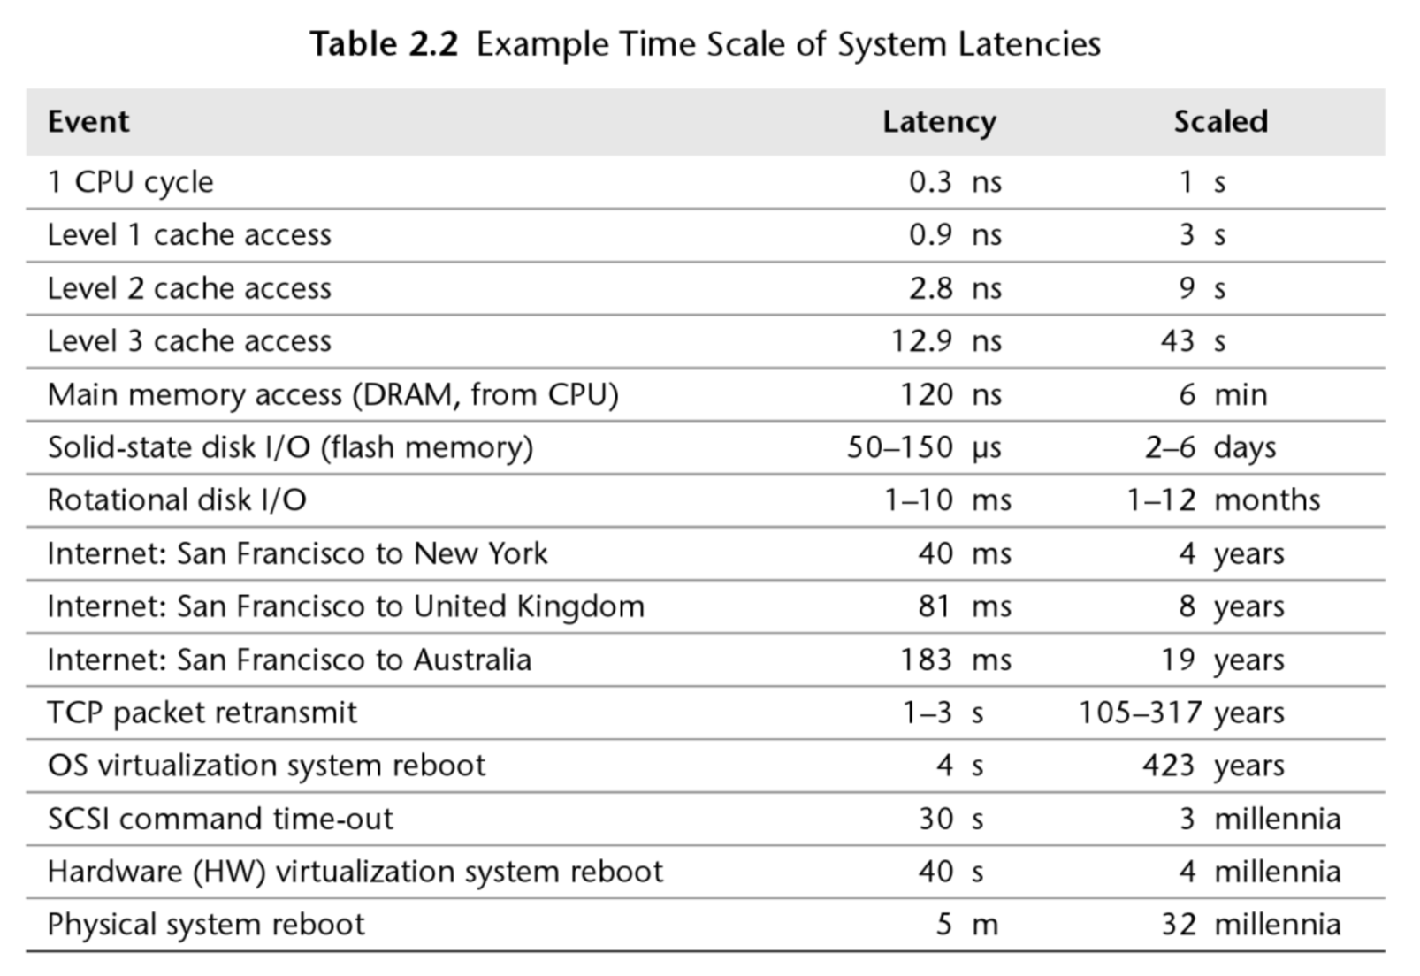
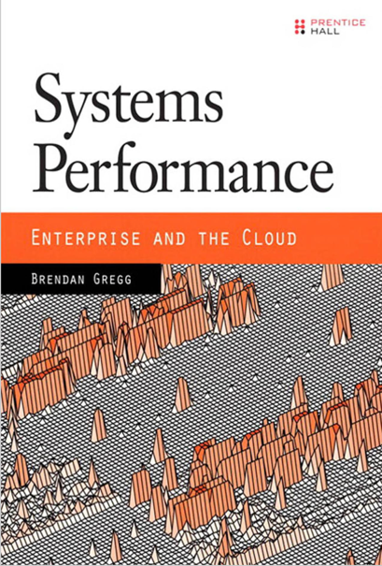

Slide 7
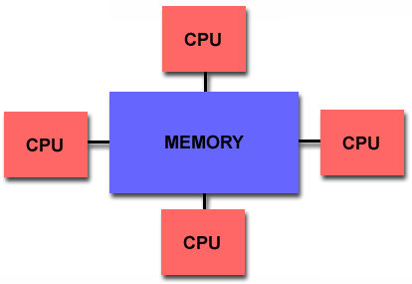
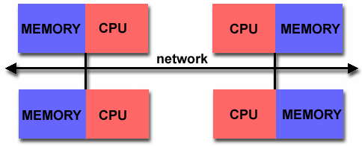
Shared Memory
All processors to access all memory as global address space.
Multiple processors can operate independently but share the same memory resources.
Changes in a memory location effected by one processor are visible to all other processors.
Distributed Memory
Processors have their own local memory. Memory addresses in one processor do not map to another processor, so there is no concept of global address space across all processors.
Changes it makes to its local memory have no effect on the memory of other processors
When a processor needs access to data in another processor, it is usually the task of the programmer to explicitly define how and when data is communicated.
Synchronization between tasks is likewise the programmer's responsibility.

Slide 8
Example of Parallelizable Problem
Calculate the potential energy for each of several thousand independent conformations of a molecule. When done, find the minimum energy conformation.
This problem is able to be solved in parallel. Each of the molecular conformations is independently determinable. The calculation of the minimum energy conformation is also a parallelizable problem.

Slide 9
Example of a Non-parallelizable Problem
Calculation of the Fibonacci series (1,1,2,3,5,8,13,21,...) by use of the formula:
F(k + 2) = F(k + 1) + F(k)
This is a non-parallelizable problem because the calculation of the Fibonacci sequence as shown would entail dependent calculations rather than independent ones. The calculation of the k + 2 value uses those of both k + 1 and k. These three terms cannot be calculated independently and therefore, not in parallel.

Slide 10
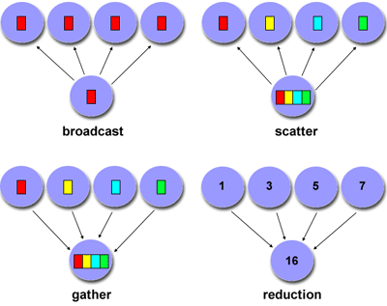
Factors to Consider
Cost of communications
Latency vs. Bandwidth
Visibility of communications (explicit vs. transparent)
Synchronous vs. asynchronous communications (blocking)
Scope of communications (point-to-point, collective)
Efficiency of communications (message passing mechanisms)

Slide 11
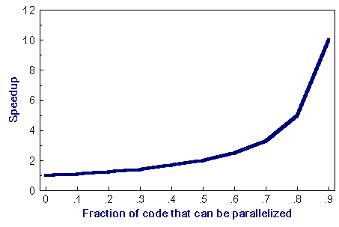
Amdahl's Law
Amdahl's Law states that potential program speedup is defined by the fraction of code (P) that can be parallelized:
1
speedup = --------
1 - P
If none of the code can be parallelized, P = 0 and the speedup = 1 (no speedup). If all of the code is parallelized, P = 1 and the speedup is infinite (in theory).
If 50% of the code can be parallelized, maximum speedup = 2, meaning the code will run twice as fast.
speedup
--------------------------------
N P = .50 P = .90 P = .99
----- ------- ------- -------
10 1.82 5.26 9.17
100 1.98 9.17 50.25
1000 1.99 9.91 90.99
10000 1.99 9.91 99.02

Slide 12
The Hadoop Eco-system
The base Apache Hadoop framework is composed of the following modules:
Hadoop Common – contains libraries and utilities needed by other Hadoop modules.
Hadoop Distributed File System (HDFS) – a distributed file-system that stores data on commodity machines, providing very high aggregate bandwidth across the cluster.
Hadoop YARN – a resource-management platform responsible for managing computing resources in clusters and using them for scheduling of users' applications.
Hadoop MapReduce – a programming model for large scale data processing.

Slide 13
Functionality
Data Management: YARN, HDFS
Data Access: Hive, Pig, MapReduce, Spark, Storm, HBase, Tez, Kafka, Hcatalog, Slider, Solar, Mahout, Accumulo
Data Governance and Integration: Falcon, Flume, Sqoop
Security: Knox, Ranger
Operations: Ambari, Oozie, Zookeeper
Description of these components

Slide 14
HDFS + MapReduce
map(key1,value) -> list<key2,value2>
reduce(key2, list<value2>) -> list<value3>

Slide 17
Usage: $HADOOP_PREFIX/bin/hadoop jar hadoop-streaming.jar [options]Options:
-input
<path> DFS input file(s) for the Map step.
-output
<path> DFS output directory for the Reduce step.
-mapper
<cmd|JavaClassName> Optional. Command to be run as mapper.
-combiner
<cmd|JavaClassName> Optional. Command to be run as combiner.
-reducer
<cmd|JavaClassName> Optional. Command to be run as reducer.

Slide 18
Map-Reduce Streaming API
$ yarn jar /usr/hdp/current/hadoop-mapreduce-client/hadoop-streaming.jar \
-input /demo/data/Website/Website-Logs/* \
-output /home/pmolnar/streamout \
-mapper /bin/cat \
-reducer /bin/cat \
-numReduceTasks 2
$ yarn jar /usr/hdp/current/hadoop-mapreduce-client/hadoop-streaming.jar \
-info
$ export HSTREAMING="$HADOOP_PREFIX/bin/hadoop jar hadoop-streaming.jar"

